Slide 1
Where the heart is
Week 5

Slide 2
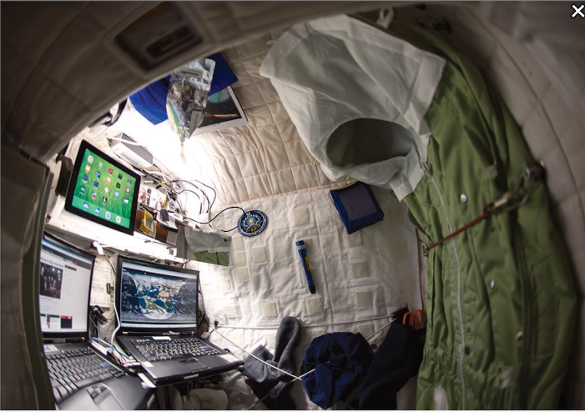
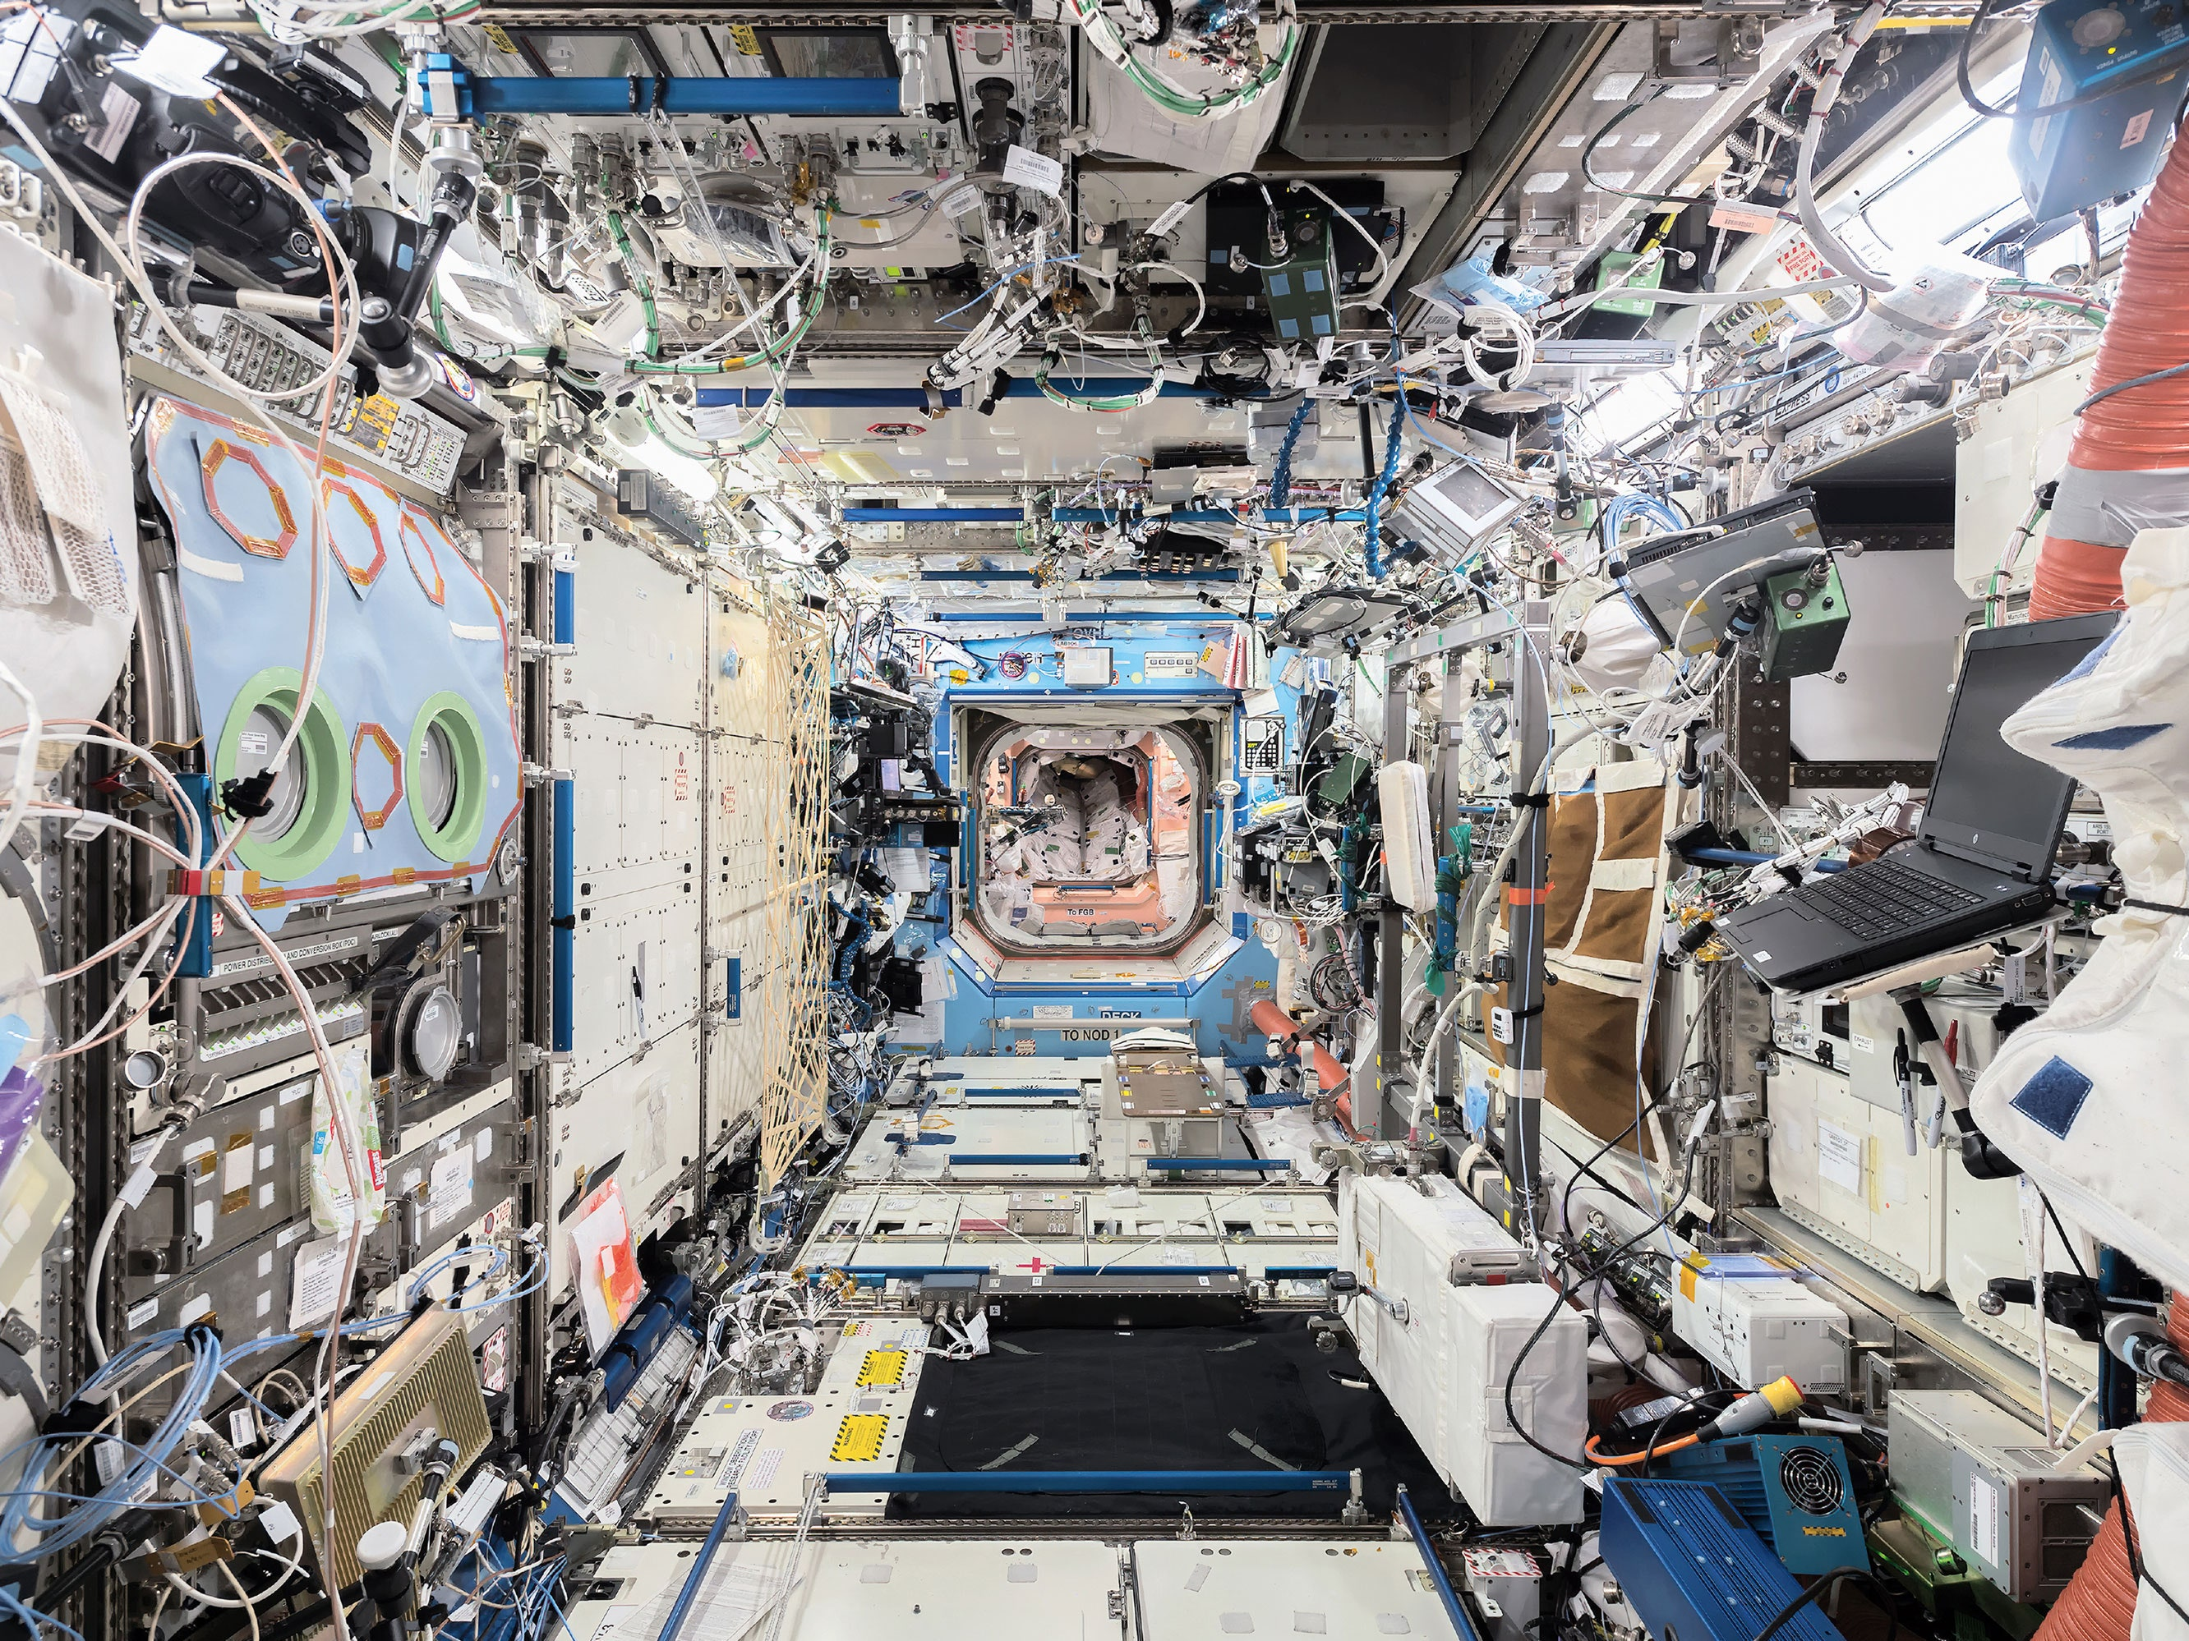
Life in ISS
Do you anything about ISS (International Space Station)?
Notes:
https://www.youtube.com/watch?v=-Y04Zic1-r4&ab_channel=TechVision

Slide 3
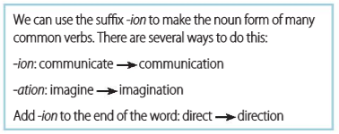
Suffix-ion

Slide 4
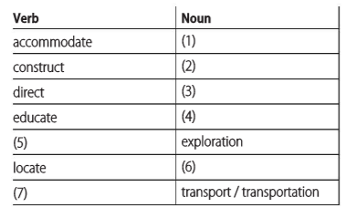
Suffix-ion
underline the stressed syllable in each word
Read the Vocabulary building box. Then type the correct missing words. Use a dictionary if necessary. For nouns, please also check they are Countable or Uncountable.
[ U ] mainly UK; [ plural ] US
accommodation
[ U ] the work of building or making something;
[ C ] a building
construction
direction
[ C ] the position towards; [ U ] control or instruction
education
[ S or U ] It's important for children to get a good education.
explore
location
[ C ] a place or position;
[ U ] the act of finding the exact position of something
transport

Slide 5
Suffix-ion
Listen again and underline the stressed syllable in each word. Which words have a different stress in the verb form and noun form?
accommodate, accommodation
construct, construction
direct, direction
educate, education
explore, exploration
locate, location
transport, transport / transportation

Slide 6
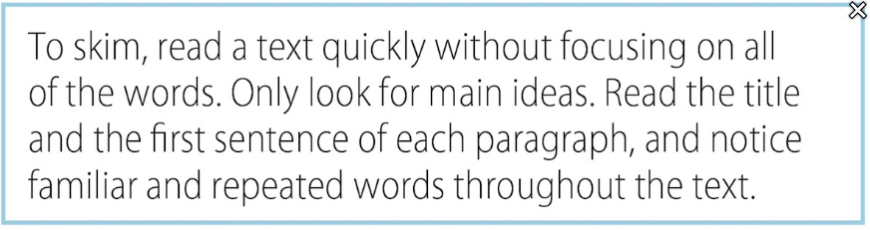
All the comforts of home
Read about skimming. Then skim the article. Choose the best description of the article.
Scanning is reading rapidly in order to find specific facts.

Slide 7
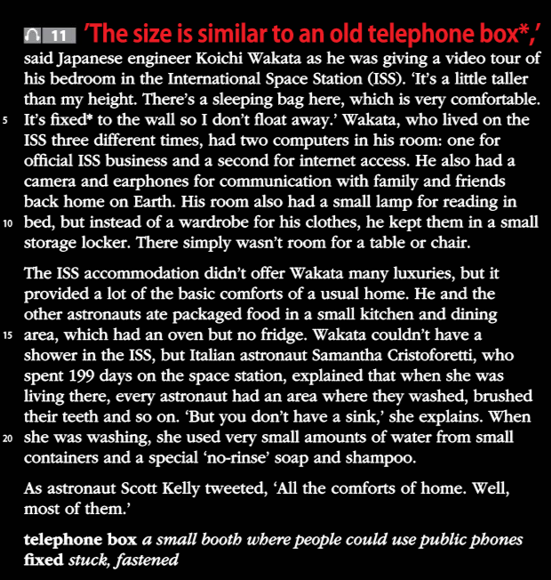
Choose the best description of the article.
a. It explains how engineers designed the living areas of the International Space Station.
b. It gives examples of problems that astronauts have living in the International Space Station.
c. It gives a description of the living areas in the International Space Station.
d. It talks about how people will build homes on Mars.

Slide 8
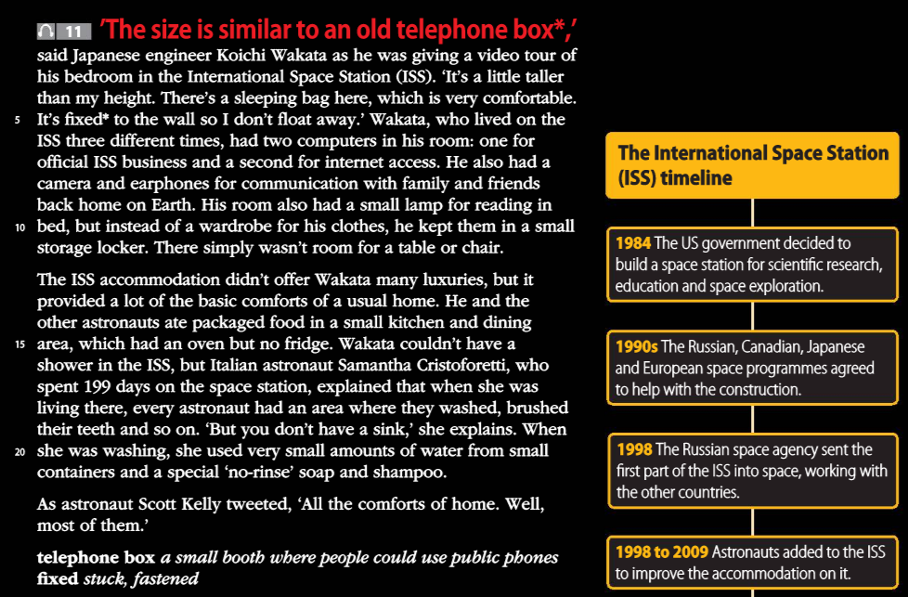
Read the article and timeline. Choose the correct option to complete each sentence.
1. Koichi Wakata’s bedroom / bed is the size of an old telephone box.
2. The bed is on the floor / wall.
3. His bedroom does / doesn’t have a chair.
4. There isn’t / is a fridge in the kitchen area.
5. There isn’t water / a sink for washing.
6. In 1984, the US government decided to construct / construction the ISS.
7. Australia / Japan helped build the ISS.
8. The first part went into space in 1998/2009.

Slide 9
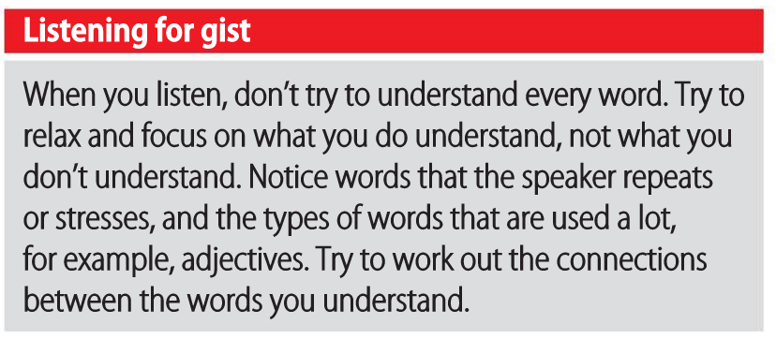
Magical houses, made of bamboo
Notes:
https://www.youtube.com/watch?v=kK_UjBmHqQw&ab_channel=TED

Slide 10
Magical houses, made of bamboo
Listen to the extract from the TED Talk. Highlight the topics Elora talks about.
doors
windows
shapes
construction materials

Slide 11
Magical houses, made of bamboo
Watch Part 1 of the talk. Choose the correct option to complete each sentence.
_______ drew a fairy mushroom house.
When Elora was a child, her mother
Last year, Elora
When she was a child, Elora
The curved roof helps keep the house _______.
dry
cool
warm
It's easy to _______ a person who is using the bathroom.
hear
see
avoid

Slide 12
Part 1- Vocabulary
Bespoke /bɪˈspoʊk/ adjective specially made for a particular person
The tropics /ˈtrɑː.pɪk/ noun the hottest area of the earth
Breeze /briːz/ noun [C] a light and pleasant wind
Hesitate /ˈhez.ə.teɪt/ verb to pause before you do or say something (to do something)
Acoustic /əˈkuː.stɪk/ adjective relating to sound or hearing
Insulation /ˌɪn.səˈleɪ.ʃən/ noun [U] the act of covering something to stop heat, sound
Bespoke
The tropics
Breeze
Hesitate
Acoustic
Insulation

Slide 13
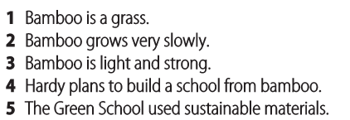
Magical houses, made of bamboo
Watch Part 2 of the talk. Are the sentences true or false?
True
False
True
False
True

Slide 14
Part 2- Vocabulary
Unproductive
Ravine
Live off
Clump
Timber
Tensile
Compressive
Slam
Unproductive /ˌʌn.prəˈdʌk.tɪv/ adjective not producing very much
Ravine /rəˈviːn/ noun [C] a deep narrow valley with steep sides
Live off phrasal verb live off sb/sth to use someone or something to provide the money or food that you need to live
Clump /klʌmp/ noun [C] a group, especially of trees or flowers; a solid mass of something such as soil; the loud sound of slow, heavy steps
Verb to walk noisily with slow, heavy steps; to form a group, or to put things into a group
Timber /ˈtɪm.bɚ/ noun [C / U] trees that are grown so that the wood from them can be used for building
Tensile /ˈten.sɪl/ adjective If a material is tensile, it can be stretched.
Compressive /kəmˈpres.ɪv/ adjective Resulting from or caused by pressure, or by pressing something into a smaller space
Slam /slæm/ verb to (cause to) move against a hard surface with force and usually a loud noise

Slide 15
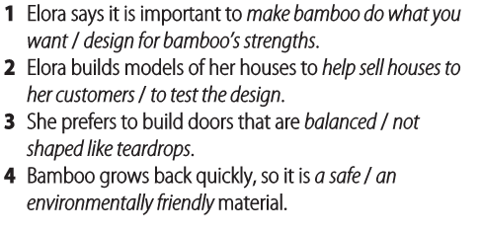
Magical houses, made of bamboo
Watch Part 3 of the talk. Choose the correct option to complete each sentence.

Slide 16
Part 3- Vocabulary
Foster
Craftsmanship
Artisan
Tapering
Tried and true
Replicate
Rectangular
Hinge
Pivot
Idealism
Foster /ˈfɑː.stɚ/ verb (+ something/someone) to encourage something to develop
Craftsmanship /ˈkræfts.mən.ʃɪp/ noun [U] skill at making things
Artisan /ˈɑːr.t̬ə.zən/ noun [C] someone who does skilled work with their hands
Tapering /ˈteɪ.pɚ.ɪŋ/ adjective becoming gradually narrower at one end
Tried and true adjective used many times in the past and proven to work well
Replicate /ˈrep.lɪ.keɪt/ verb to make or do something again in exactly the same way
Rectangular /rekˈtæŋ.ɡjə.lɚ/ adjective shaped like a rectangle
Hinge /hɪndʒ/ noun [C] a piece of metal that fastens the edge of a door
Pivot /ˈpɪv.ət/ noun [C] a fixed point supporting something that turns or balances
Idealism /aɪˈdiː.ə.lɪ.zəm/ noun [U] the belief that your ideals can be achieved

Slide 17
Speaking Assessment- IELTS speaking part 1 style questions
What is IELTS Speaking Part 1?
IELTS Speaking Part 1 is a part of the International English Language Testing System (IELTS) test. It measures your ability to speak English for academic and immigration purposes.
In IELTS Speaking Part 1, the examiner will ask you some fairly simple questions relating to your background, home, work, studies, family, everyday life, interests and hobbies.
You’ll have to answer a total of 12 questions on 3 different topics in 4-5 minutes.
https://www.youtube.com/watch?v=TneqhthYz_w

Slide 18
Speaking Assessment- IELTS speaking part 1 style questions
Student A: Study
What do you study?
Where do you study that subject?
Why did you choose that subject?
Is it a popular subject in your country?
Do you like that subject?
Student B: Hometown
Where is your hometown?
Do you visit often?
What is there for a visitor to do or see in your hometown?
How has your hometown changed since your childhood?
Is your hometown a good place to bring up children?

